Slide 1

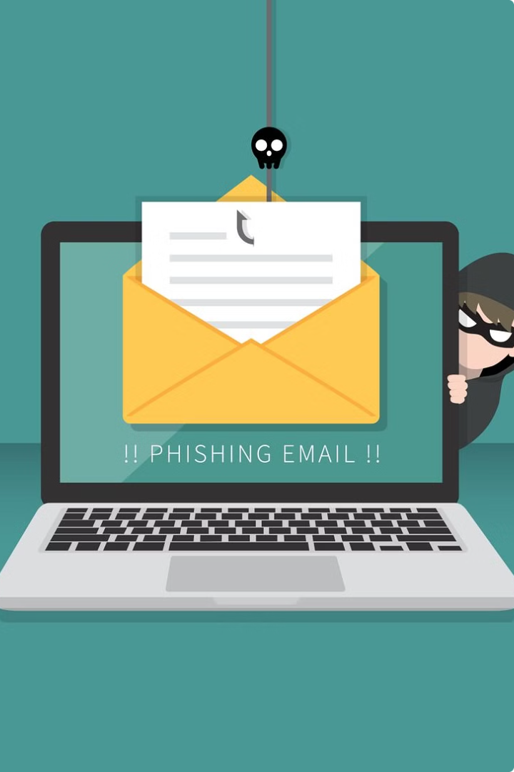

Phishing awareness module
What is Phishing?
Phishing is a type of cyber attack where hackers use fraudulent emails, text messages, or websites to trick people into revealing sensitive information or performing actions that compromise their security. Phishers often pose as legitimate organizations to lure unsuspecting victims.
by ashutosh munde

Slide 2
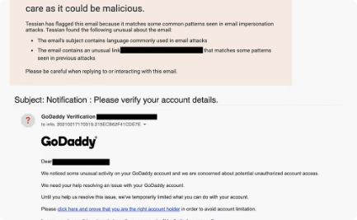
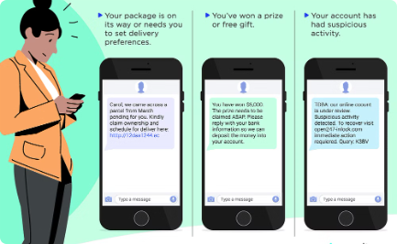
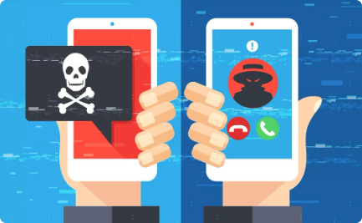
Types of Phishing Attacks
Spear Phishing
Smishing
Vishing
Targeted phishing emails that appear to be from a known or trusted source, aiming to steal sensitive information or gain access to secure systems.
Phishing attempts that occur via text messages, often impersonating banks or other organizations to trick victims into revealing personal data.
Phone-based phishing scams where attackers pose as legitimate entities and use social engineering tactics to obtain information or login credentials.

Slide 3
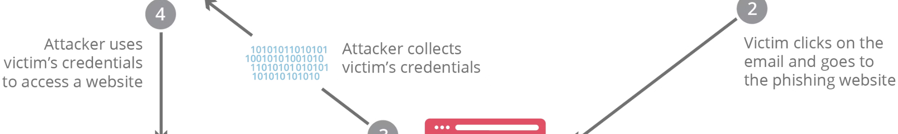
How Phishing Attacks Work
Initial Contact
1
Phishers initiate contact through methods like email, SMS, or social media, posing as legitimate organizations or individuals to gain the target's trust.
2
Lure and Deception
The phishing message often contains a sense of urgency or an enticing offer to trick the target into clicking a malicious link or providing sensitive information.
Exploit and Compromise
3
If the target falls for the phishing scheme, the attacker can gain access to confidential data, financial accounts, or install malware to further compromise the system.

Slide 4
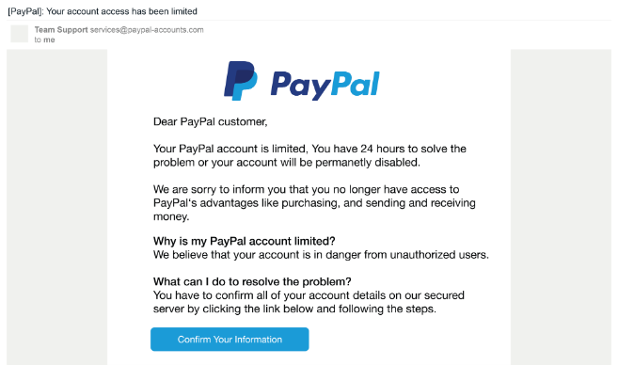
Recognizing Phishing Emails
Phishing emails often use a sense of urgency, fear, or authority to pressure you into taking action. They may claim your account has been compromised or that you need to update your information immediately.
Look for spelling and grammar errors, as well as suspicious sender email addresses that don't match the organization they claim to represent.

Slide 5
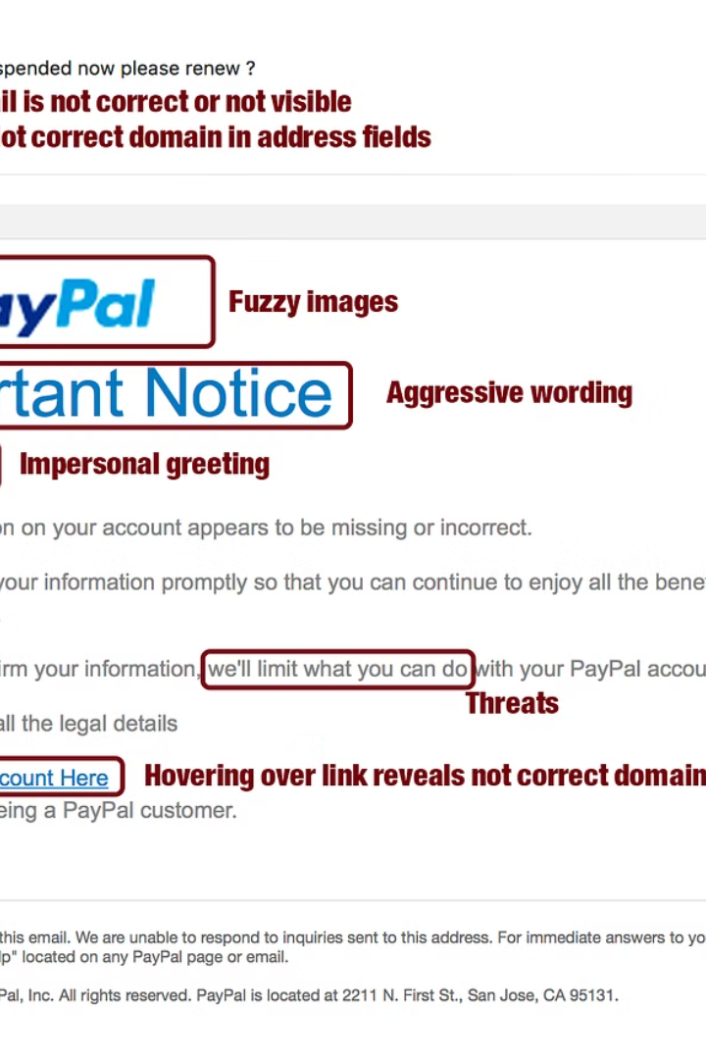
Identifying Phishing Websites
Phishers often create fake websites that mimic legitimate ones to trick users into entering their login credentials or other sensitive information. Look for signs like misspelled URLs, poor design, and security warnings to spot these deceptive sites.
Verify the URL, check for a valid SSL/TLS certificate, and be wary of sites that ask for excessive personal information. Take the time to closely inspect any website before providing any confidential data.

Slide 6
Identifying Phishing Websites
Phishers often create fake websites that mimic legitimate ones to trick users into entering their login credentials or other sensitive information. Look for signs like misspelled URLs, poor design, and security warnings to spot these deceptive sites.
Verify the URL, check for a valid SSL/TLS certificate, and be wary of sites that ask for excessive personal information. Take the time to closely inspect any website before providing any confidential data.

Slide 7
Social Engineering Tactics
Impersonation
Phishing Emails
Attackers may impersonate trusted individuals or organizations to gain your trust and lure you into disclosing sensitive information.
Phishing emails often use a sense of urgency or fear to pressure you into clicking on malicious links or attachments.
Fake Websites
Pretexting
Attackers create realistic-looking websites that mimic trusted brands to steal your login credentials or other personal information.
Crafting a plausible story or scenario to manipulate you into revealing confidential data or granting unauthorized access.

Slide 8
Common Phishing Tactics
Spoofed Email Addresses: Emails that appear to come from legitimate sources.
Urgent and Threatening Language: Messages that create a sense of urgency or fear.
Promises of Rewards or Prizes: Enticing offers to trick victims into providing information.
Requests for Personal Information: Emails asking for sensitive details.
Suspicious Attachments or Links: Unsolicited attachments or links that lead to malicious sites.

Slide 9
Recognizing Phishing Emails …..Check the Sender’s Email Address: Ensure it’s from a legitimate source.
Look for Grammatical Errors and Typos: Phishing emails often contain mistakes.
Verify URLs Before Clicking Links: Hover over links to see the actual URL.
Be Cautious of Unsolicited Attachments: Don’t open attachments from unknown senders.
Use Email Filters and Anti-Phishing Tools: These can help detect phishing emails.

Slide 10
Protecting Yourself from Phishing
Be Skeptical
Inspect URLs
Approach all unsolicited messages with caution. Verify the sender's identity before responding or clicking any links.
Look closely at the web addresses in emails and messages. Beware of misspellings or slightly altered domain names.
Enable Two-Factor Auth
Update Software
Set up two-factor authentication on your accounts to add an extra layer of security against phishing attacks.
Keep your devices and software up-to-date with the latest security patches to protect against known vulnerabilities.

Slide 11



Reporting Phishing Attempts
Be Vigilant
Notify Authorities
Forward Phishing Emails
If you suspect a message is a phishing attempt, don't click any links or provide any information. Report the incident to your organization's security team immediately.
In addition to reporting to your internal security, you should also notify the appropriate authorities, such as the FBI's Internet Crime Complaint Center (IC3), to help track and prevent future phishing attacks.
If you received a phishing email, forward it to your security team and any anti-phishing reporting email addresses provided by your organization or email provider.
Cybersecurity and Infrastructure Security Agency (CISA)
Anti-Phishing Working Group (APWG)
National Cyber Security Centre (NCSC)
Cbyerindia cyber crime portal or 1930 and also known as cyber dost

Slide 12
Best Practices for Phishing Prevention
Educate Employees
Implement Security Measures
Verify Legitimacy
Backup and Secure Data
Provide regular training on recognizing and reporting phishing attempts. Empower your team to be the first line of defense.
Encourage staff to independently verify the source of any suspicious emails or requests before taking action.
Regularly backup critical data and maintain strong access controls to limit the damage from a successful phishing attack.
Use anti-virus software, spam filters, and web content filtering to block phishing sites and suspicious emails.
Pretexting: Creating a fabricated scenario to obtain information.
Baiting: Offering something enticing to get the target to provide information.
Quid Pro Quo: Offering a service in exchange for information.
Tailgating: Physically following someone to gain access to restricted areas.

Slide 13
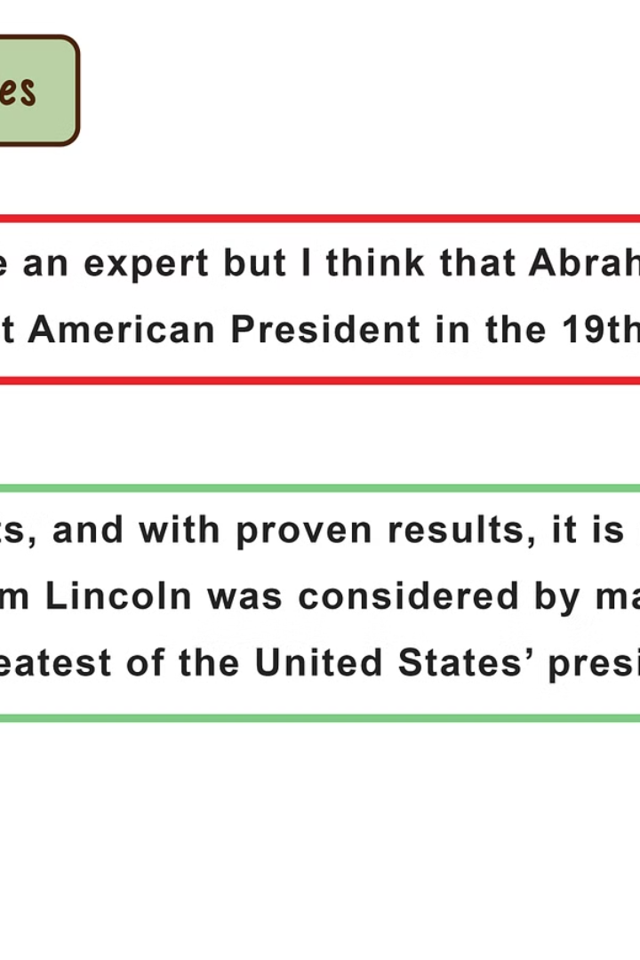
Conclusion and Resources
In conclusion, understanding phishing attacks and how to recognize them is crucial to protecting yourself and your organization. Use the resources provided to continue learning and stay vigilant against this persistent threat.

